Slide 1
Chapter 2: Configure a Network Operating System
Instructor Materials
CCNA Routing and Switching
Introduction to Networks v6.0
Notes:
Cisco Networking Academy Program
Introduction to Networks v6.0
Chapter 2: Configure a Network Operating System

Slide 2
Instructor Materials – Chapter 2 Planning Guide
This PowerPoint deck is divided in two parts:
Instructor Planning Guide
Information to help you become familiar with the chapter
Teaching aids
Instructor Class Presentation
Optional slides that you can use in the classroom
Begins on slide # 18
Note: Remove the Planning Guide from this presentation before sharing with anyone.
Notes:
2

Slide 3
Chapter 2: Configure a Network Operating System
Introduction to Networks 6.0 Planning Guide
Notes:
Cisco Networking Academy Program
Introduction to Networks v6.0
Chapter 2: Configure a Network Operating System

Slide 4
Chapter 2: Activities
What activities are associated with this chapter?
Page # | Activity Type | Activity Name | Optional?
2.0.1.2 | Class Activity | It is Just an Operating System | Optional
2.1.2.3 | Interactive Activity | Accessing Devices | Recommended
2.1.3.1 | Video Demonstration | Console Session PC to 2960 Switch | Recommended
2.1.3.3 | Video Demonstration | IOS CLI Primary Command Modes | Recommended
2.1.3.4 | Video Demonstration | Navigating Between IOS CLI Modes | Recommended
2.1.4.3 | Video Demonstration | Context-Sensitive Help & Command Syntax Check | Recommended
2.1.4.5 | Video Demonstration | Hot Keys and Shortcuts | Recommended
2.1.4.6 | Packet Tracer | Navigating the IOS | Optional
2.1.4.7 | Lab | Establishing a Console Session with Tera Term | Recommended
2.2.1.2 | Syntax Checker | Configuring the Switch Hostname | Recommended
The password used in the Packet Tracer activities in this chapter is: PT_ccna5
Notes:
4

Slide 5
Chapter 2: Activities (Cont.)
What activities are associated with this chapter?
Page # | Activity Type | Activity Name | Optional?
2.2.2.3 | Syntax Checker | Configuring Password Encryption | Recommended
2.2.2.4 | Video Demonstration | Securing Administrative Access to a Switch | Recommended
2.2.2.5 | Syntax Checker | Limit Access to a Switch | Recommended
2.2.3.2 | Video Demonstration | Saving Configurations | Recommended
2.2.3.4 | Packet Tracer | Configuring Initial Switch Settings | Optional
2.3.2.2 | Syntax Checker | Verifying Windows PC IP Configuration | Recommended
2.3.2.3 | Video Demonstration | Configuring a Switch Virtual Interface | Recommended
2.3.2.4 | Syntax Checker | Configure a Switch Virtual Interface | Recommended
2.3.2.5 | Packet Tracer | Implementing Basic Connectivity | Recommended
The password used in the Packet Tracer activities in this chapter is: PT_ccna5
Notes:
5

Slide 6
Chapter 2: Activities (Cont.)
What activities are associated with this chapter?
Page # | Activity Type | Activity Name | Optional?
2.3.3.1 | Video Demonstration | Testing the Interface Assignment | Recommended
2.3.3.2 | Video Demonstration | Testing the End-to-End Connectivity | Recommended
2.3.3.3 | Lab | Building a Simple Network | Optional
2.3.3.4 | Lab | Configuring a Switch Management Address | Recommended
2.4.1.1 | Class Activity | Tutor Me | Optional
2.4.1.2 | Packet Tracer | Skills integration Challenge | Recommended
The password used in the Packet Tracer activities in this chapter is: PT_ccna5
Notes:
6

Slide 7
Chapter 2: Assessment
Students should complete Chapter 2, “Assessment” after completing Chapter 2.
Quizzes, labs, Packet Tracers and other activities can be used to informally assess student progress.
Notes:
7

Slide 8
Chapter 2: Best Practices
Prior to teaching Chapter 2, the instructor should:
Complete Chapter 2, “Assessment.”
The objectives of this chapter are:
Explain the purpose of the Cisco IOS.
Explain how to access a Cisco IOS device for configuration purposes.
Explain how to navigate Cisco IOS to configure network devices.
Describe the command structure of the Cisco IOS software.
Configure hostnames on a Cisco IOS device using the CLI.
Use Cisco IOS commands to limit access to device configurations.
Use Cisco IOS commands to save the running configuration.
Explain how devices communicate across network media.
Configure a host device with an IP address.
Verify connectivity between two end devices.
Notes:
8

Slide 9
Chapter 2: Best Practices (Cont.)
Create a Packet Tracer with a switch (int vlan 1 configured) and a router (int g0/0 configured) so the demonstration can be used throughout the chapter.
Explain that the IOS gives networking hardware its capabilities.
? is a KEY to IOS survival. Teach the students that ? is your friend!
Students need to be aware of error messages when working in the CLI.
TeraTerm Download - http://logmett.com/index.php?/download/free-downloads.html
Mini-USB Console Cable – Driver is needed (http://software.cisco.com/download/release.html?mdfid=282774238&flowid=714&softwareid=282855122&release=3.1&relind=AVAILABLE&rellifecycle=&reltype=latest) and USB to mini-USB cables are needed.
Notes:
9

Slide 10
Chapter 2: Best Practices (Cont.)
When a student presses Enter to complete a command, check to make sure the command was accepted.
Explain to the students that this chapter covers three basic concepts required for setting up and testing a network:
Before configuring devices, you must know the functions of the Cisco IOS devices, know how to communicate with the IOS, and how to physically connect to the devices.
Know the basics of device configurations, including securing the device, naming devices, and enabling interfaces.
Know the basic tools for verifying network connectivity, such as ping and traceroute.
Ensure the class knows that a router or a switch runs an IOS. Ask volunteers to explain how access is gained to the IOS.
Devices can be accessed via the console port (a direct physical connection), via Telnet, SSH (a virtual connection), HTTP, or via AUX (telephone modem or ISDN)
Notes:
10

Slide 11
Chapter 2: Best Practices (Cont.)
Write the following configuration modes on the board and ask the class to explain or define these modes:
user EXEC mode
privileged EXEC mode
global configuration mode
Explain to the class that devices come with default names.
Explain that names are not assigned randomly. For example, a router is named “router” by default and a switch is “switch”.
Use show running-configuration to see the configuration statement “hostname switch” or “hostname router”.
A networking professional creates a naming convention that spans the company to maintain continuity and prepare for future growth.
Notes:
11

Slide 12
Chapter 2: Best Practices (Cont.)
Display a router interface and demonstrate the modes and their associated prompts.
Demonstrate how to back out from privileged EXEC mode to user EXEC mode with the disable command.
Demonstrate the various forms of context-sensitive Help available.
Demonstrate, with a preconfigured configuration, an end-to-end connection with ping and traceroute.
Reinforce that show commands serve as powerful troubleshooting tools.
Notes:
12

Slide 13
Chapter 2: Best Practices (Cont.)
Make sure students understand “delimiting character”.
Explain that other than physical security of equipment, which is always necessary, there are also ways to use passwords to add additional security. On the board, write the four password types students will learn to configure in the PT Activity:
console password – Password to limit device access using the console connection.
enable password – Password to limit access to the privileged EXEC mode.
enable secret password – Encrypted password to limit access to the privileged EXEC mode.
VTY password – Password to limit device access using Telnet.
Emphasize the use of the copy running-config startup-config or copy run start commands.
Notes:
13

Slide 14
Chapter 2: Best Practices (Cont.)
Emphasize to students that they can use the show run command to see commands, such as hostname and line console 0.
Explain that there are two types of configuration files:
Startup configuration files (startup-config) - These are stored in NVRAM and remain intact if the router is powered off.
Running configuration file (running-config) - Each time a router is booted up, the startup-config is loaded into RAM and becomes the second type of config file, which is the running configuration file. This file will change immediately if an administrator makes a change to a device. This change will cause the running-config to be different from the startup-config. Because the running-config is stored in RAM, if a power cycle takes place without saving the changes from running-config to the startup-config, any changes made will be lost.
Notes:
14

Slide 15
Chapter 2: Best Practices (Cont.)
Write the following definitions on the board and then ask the students to name the command:
Shows the config file in RAM. (show running-config)
This file is immediately changed if you make any changes to the router. (running-config)
This file is in NVRAM and will become the running-config in the event of a power cycle. (startup-config)
Copies the current configuration in RAM to NVRAM. (copy running-config startup-config)
Causes the device to reload the startup-config into RAM. (reload)
Mention to the students that a text file created can be used as a record of how the device is currently implemented and be used to restore a configuration.
The file would require editing before being used to restore a saved configuration to a device.
For instance, interfaces have to be re-enabled using the no shutdown command.
Notes:
15

Slide 16
Chapter 2: Additional Help
For additional help with teaching strategies, including lesson plans, analogies for difficult concepts, and discussion topics, visit the CCNA Community at: https://www.netacad.com/group/communities/community-home
Best practices from around the world for teaching CCNA Routing and Switching. https://www.netacad.com/group/communities/ccna
If you have lesson plans or resources that you would like to share, upload them to the CCNA Community in order to help other instructors.
Students can enroll in Introduction to Packet Tracer (self-paced)
Notes:
16

Slide 18
Chapter 2: Configure a Network Operating System
CCNA Routing and Switching
Introduction to Networks v6.0
Notes:
Cisco Networking Academy Program
Introduction to Networks v6.0
Chapter 2: Configure a Network Operating System

Slide 19
Chapter 2 - Sections & Objectives
2.1 IOS Bootcamp
Explain the features and functions of the Cisco IOS Software.
Explain the purpose of Cisco IOS.
Explain how to access a Cisco IOS device for configuration purposes.
Explain how to navigate Cisco IOS to configure network devices.
Describe the command structure of Cisco IOS software.
2.2 Basic Device Configuration
Configure initial settings on a network device using the Cisco IOS Software.
Configure hostnames on a Cisco IOS device using the CLI.
Use Cisco IOS commands to limit access to device configurations.
Use IOS commands to save the running configuration.
Notes:
19
Cisco Networking Academy Program
Introduction to Networks v6.0
Chapter 2: Configure a Network Operating System

Slide 20
Chapter 2 - Sections & Objectives (Cont.)
2.3 Address Schemes
Given an IP addressing scheme, configure IP address parameters on devices to provide end-to-end connectivity in a small to medium-sized business network.
Explain how devices communicate across network media.
Configure a host device with an IP address.
Verify connectivity between two end devices.
Notes:
20
Cisco Networking Academy Program
Introduction to Networks v6.0
Chapter 2: Configure a Network Operating System

Slide 21
2.1 IOS Bootcamp
Notes:
2 - Configure a Network Operating System
2.1 – IOS Bootcamp

Slide 22
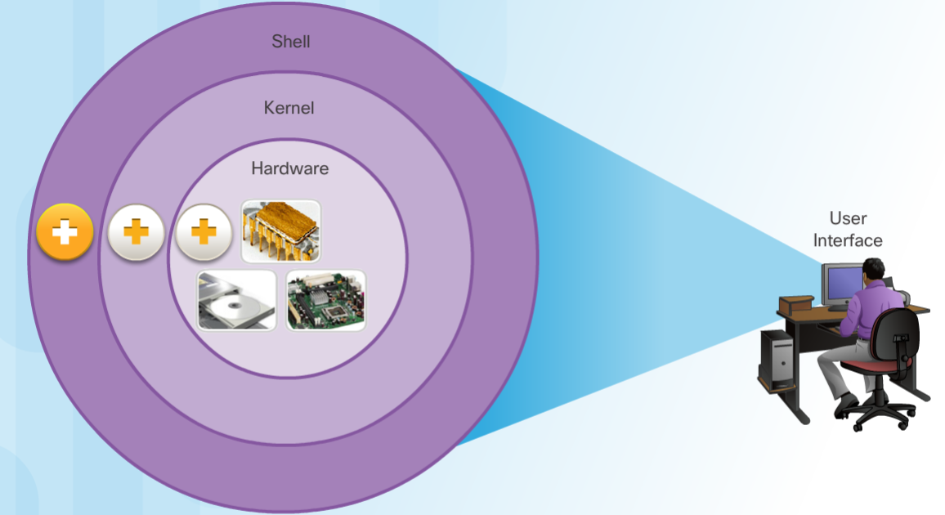
Cisco IOS Operating System
Cisco devices use the Cisco Internetwork Operating System (IOS).
Although used by Apple, iOS is a registered trademark of Cisco in the U.S. and other countries and is used by Apple under license.
All electronic devices require an operating system.
Windows, Mac, and Linux for PCs and laptops
Apple iOS and Android for smart phones and tablets
Cisco IOS for network devices (e.g., switches, routers, wireless AP, firewall, …).
OS Shell
The OS shell is either a command-line interface (CLI) or a graphical user interface (GUI) and enables a user to interface with applications.
OS Kernel
The OS kernel communicates directly with the hardware and manages how hardware resources are used to meet software requirements.
Hardware
The physical part of a computer including underlying electronics.
Notes:
2.1 – IOS Bootcamp
2.1.1 – Cisco IOS
2.1.1.1 – Operating System

Slide 23
Cisco IOS Purpose of OS
Using a GUI enables a user to:
Use a mouse to make selections and run programs
Enter text and text-based commands
Using a CLI on a Cisco IOS switch or router enables a network technician to:
Use a keyboard to run CLI-based network programs
Use a keyboard to enter text and text-based commands
There are many distinct variations of Cisco IOS:
IOS for switches, routers, and other Cisco networking devices
IOS numbered versions for a given Cisco networking devices
Notes:
2.1 – IOS Bootcamp
2.1.1 – Cisco IOS
2.1.1.2 – Purpose of OS

Slide 24
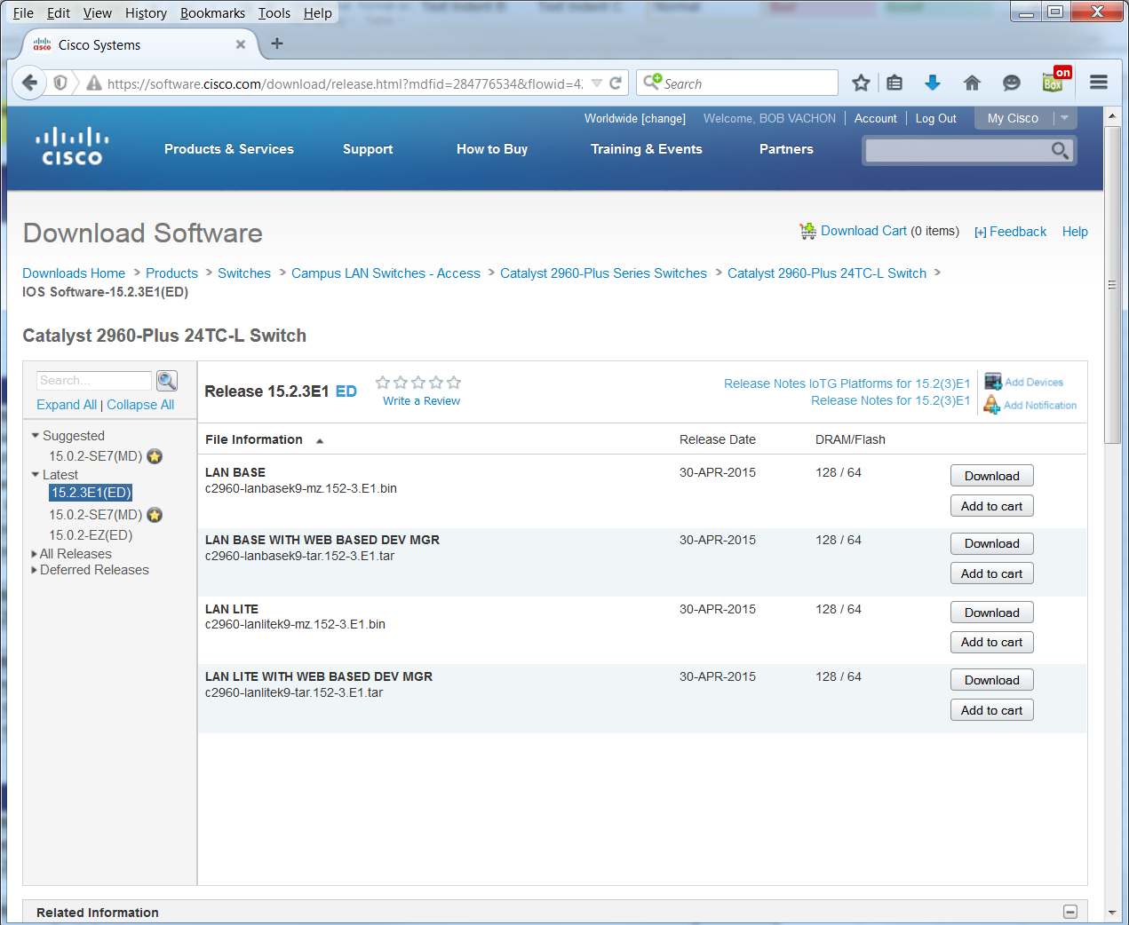
Cisco IOS Purpose of OS (Cont.)
All devices come with a default IOS and feature set. It is possible to upgrade the IOS version or feature set.
An IOS can be downloaded from cisco.com. However, a Cisco Connection Online (CCO) account is required.
Note: The focus of this course will be on Cisco IOS Release 15.x.
Notes:
2.1 – IOS Bootcamp
2.1.1 – Cisco IOS
2.1.1.2 – Purpose of OS

Slide 25
Cisco IOS Access Access Methods
The three most common ways to access the IOS are:
Console port – Out-of-band serial port used primarily for management purposes such as the initial configuration of the router.
Secure Shell (SSH) - Inband method for remotely and securely establishing a CLI session over a network. User authentication, passwords, and commands sent over the network are encrypted. As a best practice, use SSH instead of Telnet whenever possible.
Telnet – Inband interfaces remotely establishing a CLI session through a virtual interface, over a network. User authentication, passwords, and commands are sent over the network in plaintext.
Note: The AUX port is an on older method of establishing a CLI session remotely via a telephone dialup connection using a modem.
Notes:
2.1 – IOS Bootcamp
2.1.2 – Cisco IOS Access
2.1.2.1 – Access Methods

Slide 26
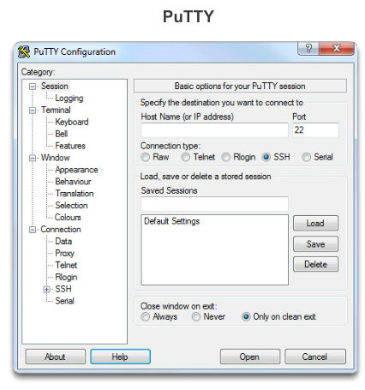
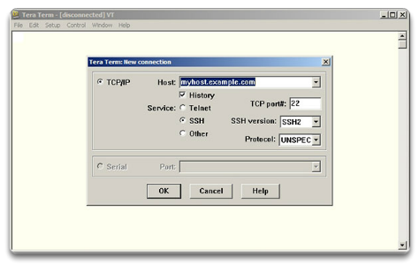
Cisco IOS Access Terminal Emulation Program
Regardless of access method, a terminal emulation program will be required. Popular terminal emulation programs include PuTTY, Tera Term, SecureCRT, and OS X Terminal.
Tera Term
Notes:
2.1 – IOS Bootcamp
2.1.2 – Cisco IOS Access
2.1.2.2 – Terminal Emulation Programs

Slide 27
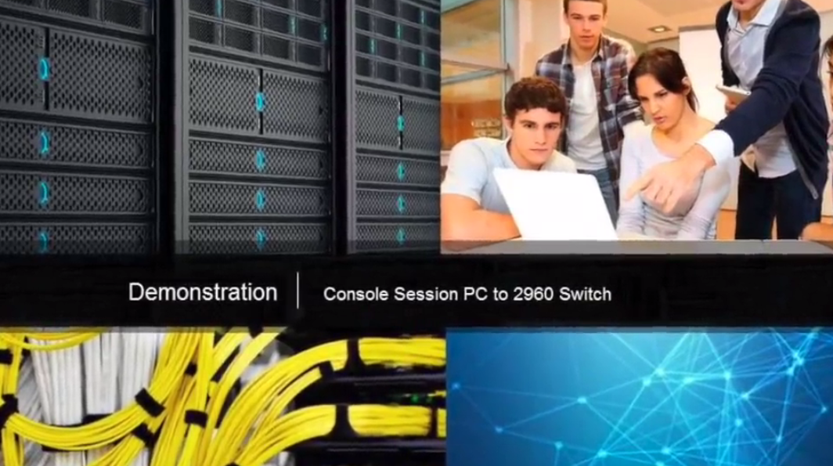
Navigate the IOS Cisco IOS Modes of Operation
The Cisco IOS modes use a hierarchical command structure.
Each mode has a distinctive prompt and is used to accomplish particular tasks with a specific set of commands that are available only to that mode.
Notes:
2.1 – IOS Bootcamp
2.1.3 – Navigate the IOS
2.1.3.1 – Cisco IOS Modes of Operation

Slide 28
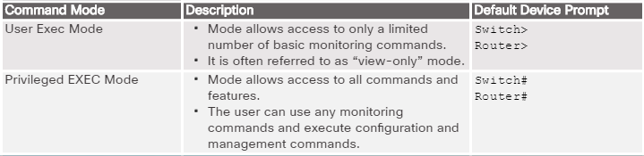
Navigate the IOS Primary Command Modes
The user EXEC mode allows only a limited number of basic monitoring commands.
Often referred to as “view-only” mode.
By default, there is no authentication required to access the user EXEC mode but it should be secured.
The privileged EXEC mode allows the execution of configuration and management commands.
Often referred to as “enable mode” because it requires the enable user EXEC command.
By default, there is no authentication required to access the user EXEC mode but it should be secured.
Notes:
2.1 – IOS Bootcamp
2.1.3 – Navigate the IOS
2.1.3.2 – Primary Command Modes

Slide 29
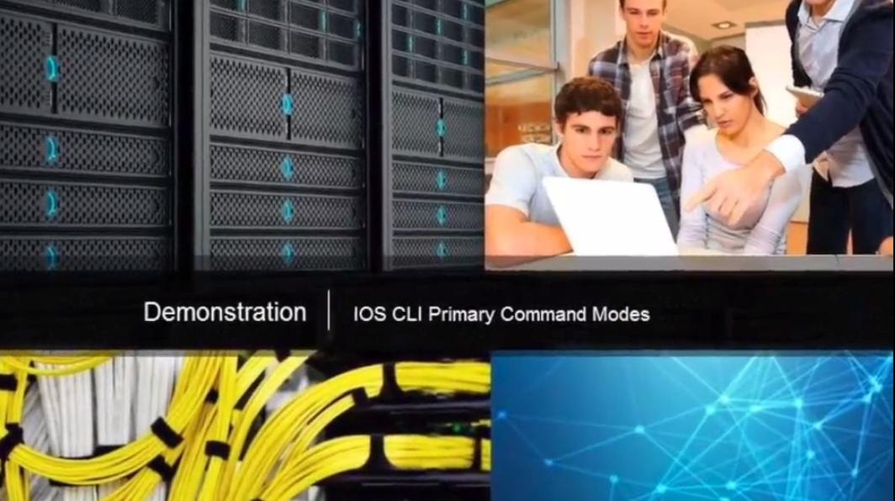
Navigate the IOS Configuration Command Modes
The primary configuration mode is called global configuration or simply, global config.
Use the configure terminal command to access.
Changes made affect the operation of the device.
Specific sub configuration modes can be accessed from global configuration mode. Each of these modes allows the configuration of a particular part or function of the IOS device.
Interface mode - to configure one of the network interfaces.
Line mode - to configure the console, AUX, Telnet, or SSH access.
Notes:
2.1 – IOS Bootcamp
2.1.3 – Navigate the IOS
2.1.3.3 – Configuration Command Modes

Slide 30
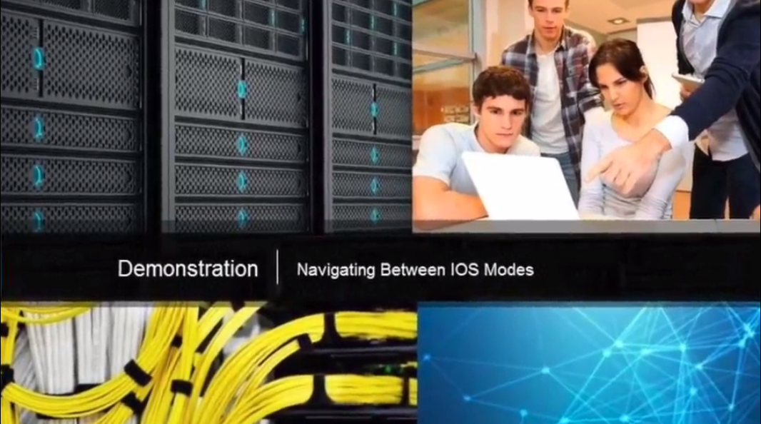
Navigate the IOS Navigate Between IOS Modes
Various commands are used to move in and out of command prompts:
To move from user EXEC mode to privileged EXEC mode, use the enable command.
Use return to user EXEC mode, use the disable command.
Various methods can be used to exit / quit configuration modes:
exit - Used to move from a specific mode to the previous more general mode, such as from interface mode to global config.
end - Can be used to exit out of global configuration mode regardless of which configuration mode you are in.
^z - Works the same as end.
Notes:
2.1 – IOS Bootcamp
2.1.3 – Navigate the IOS
2.1.3.4 – Navigate Between IOS Modes

Slide 31
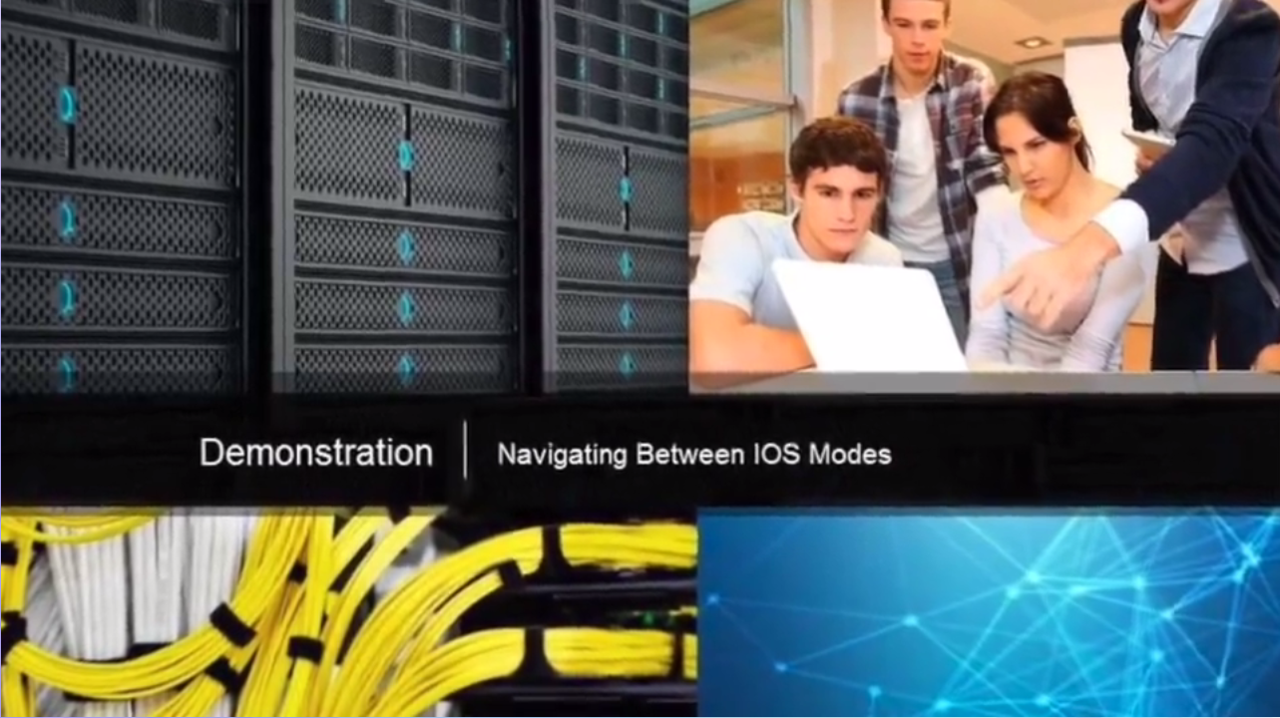
Navigate the IOS Navigate Between IOS Modes (Cont.)
The following provides an example of navigating between IOS modes:
Enter privileged EXEC mode using the enable command.
Enter global config mode using the configure terminal command.
Enter interface sub-config mode using the interface fa0/1 command.
Exit out of each mode using the exit command.
The remainder of the configuration illustrates how you can exit a sub-config mode and return to privileged EXEC mode using either the end or ^Z key combination.
Notes:
2.1 – IOS Bootcamp
2.1.3 – Navigate the IOS
2.1.3.4 – Navigate Between IOS Modes

Slide 32
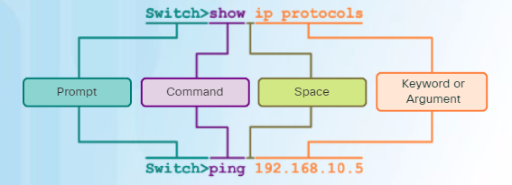
The Command Structure Basic IOS Command Structure
A Cisco IOS device supports many commands. Each IOS command has a specific format or syntax and can only be executed at the appropriate mode.
The syntax for a command is the command followed by any appropriate keywords and arguments.
Keyword - a specific parameter defined in the operating system (in the figure, ip protocols)
Argument - not predefined; a value or variable defined by the user (in the figure, 192.168.10.5)
After entering each complete command, including any keywords and arguments, press the Enter key to submit the command to the command interpreter.
Notes:
2.1 – IOS Bootcamp
2.1.4 – The Command Structure
2.1.4.1 – Basic IOS Command Structure

Slide 33
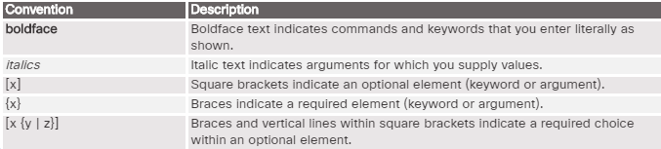
The Command Structure IOS Command Syntax
To determine the keywords and arguments required for a command, refer to the command syntax
Refer to the following table when looking at command syntax.
Examples:
description string - The command is used to add a description to an interface. The string argument is text entered by the administrator such as description Connects to the main headquarter office switch.
ping ip-address - The command is ping and the user-defined argument is the ip-address of the destination device such as in ping 10.10.10.5
Notes:
2.1 – IOS Bootcamp
2.1.4 – The Command Structure
2.1.4.2 – IOS Command Syntax

Slide 34
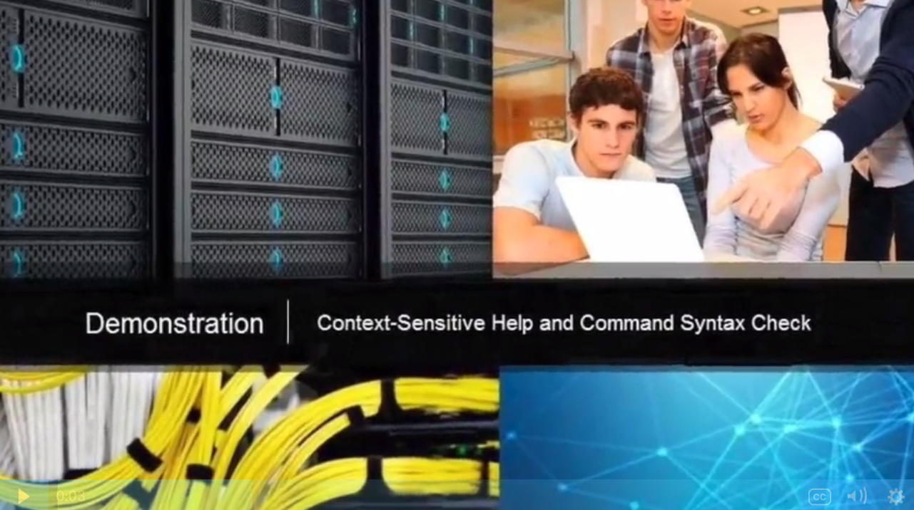
The Command Structure IOS Help Features
IOS Context-Sensitive Help:
Context-sensitive help provides a list of commands and the arguments associated with those commands
within the context of the current mode.
To access context-sensitive help, enter a question mark ?, at any prompt.
Notes:
2.1 – IOS Bootcamp
2.1.4 – The Command Structure
2.1.4.3 – IOS Help Features

Slide 35
The Command Structure IOS Help Features (Cont.)
IOS Command Syntax Check:
The command line interpreter checks an entered command from left to right to determine what action is being requested.
If the interpreter understands the command, the requested action is executed and the CLI returns to the appropriate prompt.
If the interpreter discovers an error, the IOS generally provides feedback such as “Ambiguous command”, “Incomplete command”, or “Incorrect command”.
Notes:
2.1 – IOS Bootcamp
2.1.4 – The Command Structure
2.1.4.3 – IOS Help Features

Slide 36
The Command Structure Hot Keys and Shortcuts
Commands and keywords can be shortened to the minimum number of characters that identify a unique selection.
For example, the configure command can be shortened to conf because configure is the only command that begins with conf.
An even shorter version of con will not work because more than one command begins with con.
Keywords can also be shortened.
Notes:
2.1 – IOS Bootcamp
2.1.4 – The Command Structure
2.1.4.4 – Hot Keys and Shortcuts

Slide 37
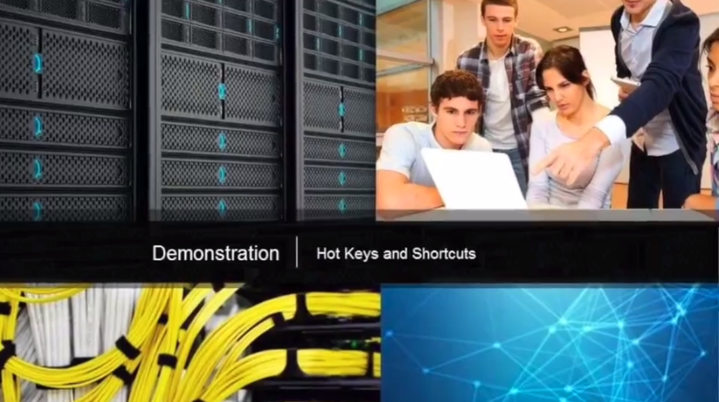
The Command Structure Video Demonstration - Hotkeys and Shortcuts
The IOS CLI support the following hotkeys:
Down Arrow – Allows the user to scroll through command history.
Up Arrow - Allows the user to scroll backward through commands.
Tab - Completes the remainder of a partially entered command.
Ctrl-A - Moves to the beginning of the line.
Ctrl-E – Moves to the end of the line.
Ctrl-R – Redisplays a line.
Ctrl-Z – Exits the configuration mode and returns to user EXEC.
Ctrl-C – Exits the configuration mode or aborts the current command.
Ctrl-Shift-6 – Allows the user to interrupt an IOS process (e.g., ping).
Notes:
2.1 – IOS Bootcamp
2.1.4 – The Command Structure
2.1.4.5 – Video Demonstration - Hot Keys and Shortcuts

Slide 38
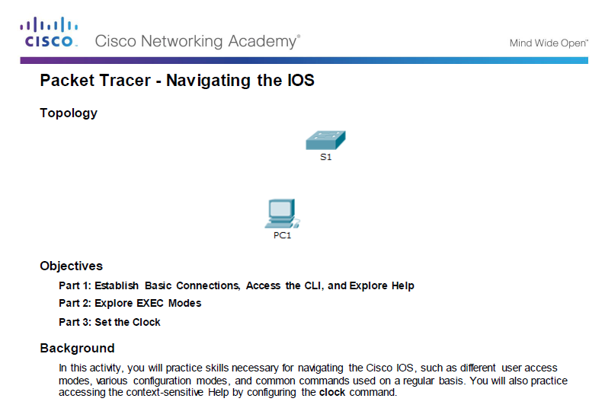
The Command Structure Packet Tracer - Navigating the IOS
Notes:
2.1 – IOS Bootcamp
2.1.4 – The Command Structure
2.1.4.6 – Packet Tracer – Navigating the IOS

Slide 39
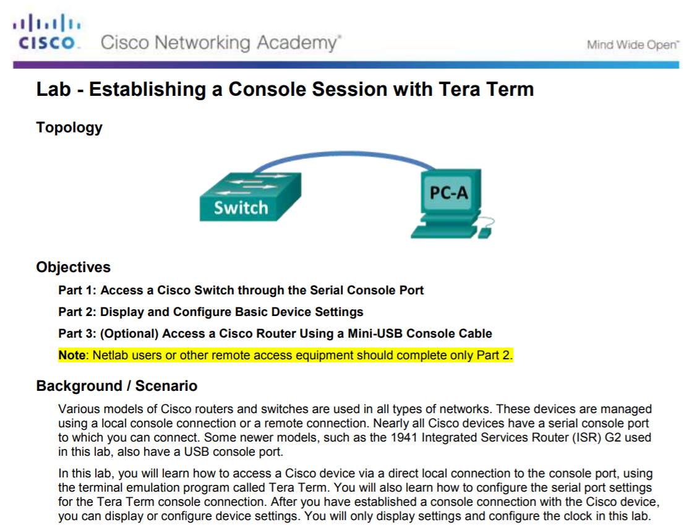
The Command Structure Lab – Establishing a Console Session with Tera Term
Notes:
2.1 – IOS Bootcamp
2.1.4 – The Command Structure
2.1.4.7 – Lab – Establishing a Console Session with Tera Term

Slide 40
2.2 Basic Device Configuration
Notes:
2 - Configure a Network Operating System
2.2 – Basic Device Configuration

Slide 41
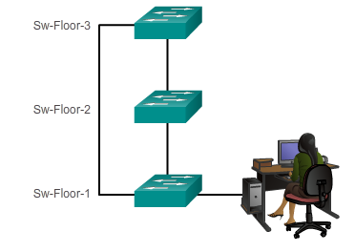
Hostnames Device Names
The first step when configuring a switch is to assign it a unique device name, or hostname.
Hostnames appear in CLI prompts, can be used in various authentication processes between devices, and should be used on topology diagrams.
Without a hostname, network devices are difficult to identify for configuration purposes.
Hostnames enables an administrator to name a device making it easier to identify in a network.
Notes:
2.2 – Basic Device Configuration
2.2.1 – Hostnames
2.2.1.1 – Device Names

Slide 42
Hostnames Configure Hostnames
Once the naming convention has been identified, the next step is to apply the names to the devices using the CLI.
The hostname name global configuration command is used to assign a name.
Switch>
Switch> enable
Switch#
Switch# configure terminal
Switch(config)# hostname Sw-Floor-1
Sw-Floor-1(config)#
Notes:
2.2 – Basic Device Configuration
2.2.1 – Hostnames
2.2.1.2 – Configure Hostnames

Slide 43
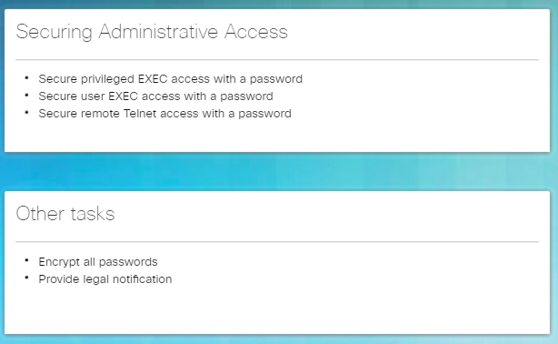
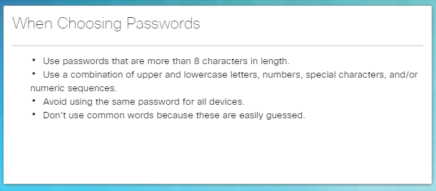
Limit Access to Device Configurations Limiting Device Access
Step 1 - Secure network devices to physically limit access by placing them in wiring closets and locked racks.
Step 2 - Enforce secure passwords as passwords are the primary defense against unauthorized access to network devices.
Limit administrative access as follows.
Use strong password as suggested.
For convenience, most labs and examples in this course use the simple but weak passwords cisco or class.
Notes:
2.2 – Basic Device Configuration
2.2.2 – Limit Access to Device Configurations
2.2.2.1 – Secure Device Access

Slide 44
Limit Access to Device Configurations Configure Passwords
Secure privileged EXEC access using the enable secret password global config command.
Secure user EXEC access by configuring the line console as follows:
Secure remote Telnet or SSH access by configuring the Virtual terminal (VTY) lines as follows:
Securing User EXEC Mode | Description
Switch(config)# line console 0 | Command enters line console configuration mode.
Switch(config-line)# password password | Command specifies the line console password.
Switch(config-line)# login | Command makes the switch require the password.
Securing Remote Access | Description
Switch(config)# line vty 0 15 | Cisco switches typically support up to 16 incoming VTY lines numbered 0 to 15.
Switch(config-line)# password password | Command specifies the VTY line password.
Switch(config-line)# login | Command makes the switch require the password.
Notes:
2.2 – Basic Device Configuration
2.2.2 – Limit Access to Device Configurations
2.2.2.2 – Configure Passwords

Slide 45
Limit Access to Device Configurations Configure Passwords (Cont.)
Secure Privileged EXEC | Sw-Floor-1(config)# enable secret class Sw-Floor-1(config)# exit Sw-Floor-1# Sw-Floor-1# disable Sw-Floor-1> enable Password: Sw-Floor-1#
Securing User EXEC | Sw-Floor-1(config)# line console 0 Sw-Floor-1(config-line)# password cisco Sw-Floor-1(config-line)# login Sw-Floor-1(config-line)# exit Sw-Floor-1(config)#
Securing Remote Access | Sw-Floor-1(config)# line vty 0 15 Sw-Floor-1(config-line)# password cisco Sw-Floor-1(config-line)# login Sw-Floor-1(config-line)#
Notes:
2.2 – Basic Device Configuration
2.2.2 – Limit Access to Device Configurations
2.2.2.2 – Configure Passwords

Slide 46
Limit Access to Device Configurations Encrypt Passwords
The startup-config and running-config files display most passwords in plaintext. This is a security threat because anyone can see the passwords if they have access to these files.
Sw-Floor-1(config)# service password-encryption
S1(config)# exit
S1# show running-config
<output omitted>
service password-encryption
!
hostname S1
!
enable secret 5 $1$mERr$9cTjUIEqNGurQiFU.ZeCi1
!
<Output omitted>
line con 0
password 7 0822455D0A16
login
!
line vty 0 4
password 7 0822455D0A16
login
line vty 5 15
password 7 0822455D0A16
login!
Use the service password-encryption global config command to encrypt all passwords.
The command applies weak encryption to all unencrypted passwords.
However, it does stop “shoulder surfing”.
Notes:
2.2 – Basic Device Configuration
2.2.2 – Limit Access to Device Configurations
2.2.2.3 – Encrypt Passwords

Slide 47
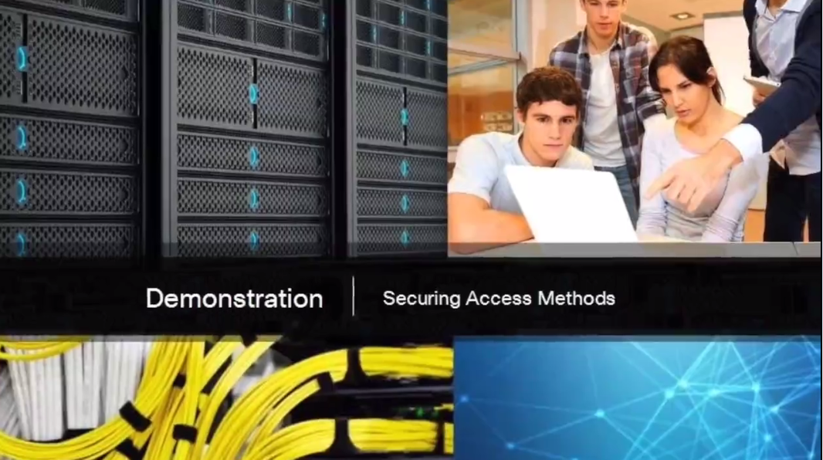
Limit Access to Device Configurations Banner Messages
Banners are messages that are displayed when someone attempts to gain access to a device. Banners are an important part of the legal process in the event that someone is prosecuted for breaking into a device.
Configured using the banner motd delimiter message delimiter command from global configuration mode. The delimiting character can be any character as long as it isunique and does not occur in the message (e.g., #$%^&*)
Notes:
2.2 – Basic Device Configuration
2.2.2 – Limit Access to Device Configurations
2.2.2.4 – Banner Messages

Slide 48
Limit Access to Device Configurations Syntax Checker – Limiting Access to a Switch
Encrypt all passwords.
Sw-Floor-1(config)# service password-encryption
Sw-Floor-1(config)#
Secure the privileged EXEC access with the password Cla55.
Sw-Floor-1(config)# enable secret Cla55
Sw-Floor-1(config)#
Secure the console line. Use the password Cisc0 and allow login.
Sw-Floor-1(config)# line console 0
Sw-Floor-1(config-line)# password Cisc0
Sw-Floor-1(config-line)# login
SW-Floor-1(config-line)# exit
Sw-Floor-1(config)#
Secure the first 16 VTY lines. Use the password Cisc0 and allow login.
Sw-Floor-1(config)# line vty 0 15
Sw-Floor-1(config-line)# password Cisc0
Sw-Floor-1(config-line)# login
Sw-Floor-1(config-line)# end
Sw-Floor-1#
Notes:
2.2 – Basic Device Configuration
2.2.2 – Limit Access to Device Configurations
2.2.2.5– Syntax Checker – Limiting Access to a Switch

Slide 49
Save Configurations Save the Running Configuration File
Cisco devices use a running configuration file and a startup configuration file.
The running configuration file is stored in RAM and contains the current configuration on a Cisco IOS device.
Configuration changes are stored in this file.
If power is interrupted, the running config is lost.
Use the show startup-config command to display contents.
The startup config file is stored in NVRAM and contains the configuration that will be used by the device upon reboot.
Typically the running config is saved as the startup config.
If power is interrupted, it is not lost or erased.
Use the show running-config command to display contents.
Use the copy running-config startup-config command to save the running configuration.
Notes:
2.2 – Basic Device Configuration
2.2.3 – Save Configurations
2.2.3.1 – Save the Running Configuration File

Slide 50

Save Configurations Alter the Running Configuration
If configuration changes do not have the desired effect, they can be removed individually or the device can be rebooted to the last saved configuration using the reload privileged EXEC mode command.
The command restores the startup-config.
A prompt will appear to ask whether to save the changes. To discard the changes, enter n or no.
Alternatively, if undesired changes were saved to the startup configuration, it may be necessary to clear all the configurations using the erase startup-config privileged EXEC mode command.
Notes:
2.2 – Basic Device Configuration
2.2.3 – Save Configurations
2.2.3.2 – Alter the Running Configuration

Slide 51
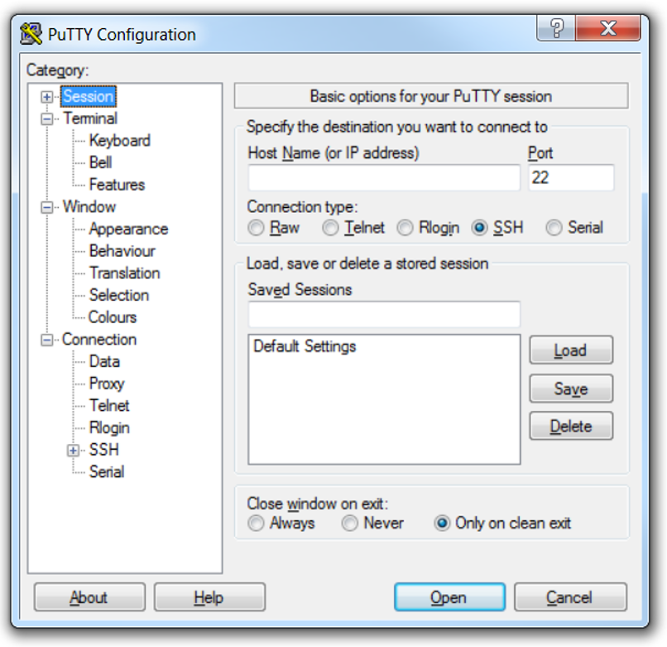
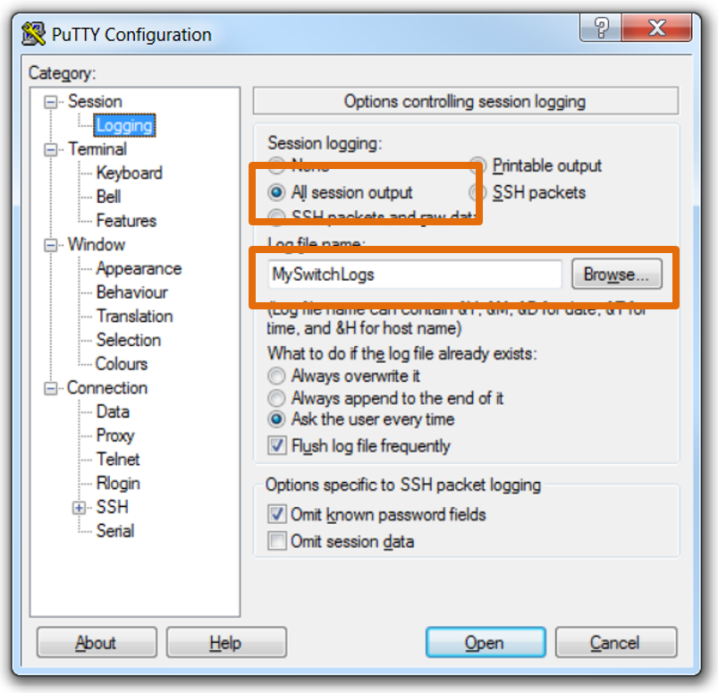
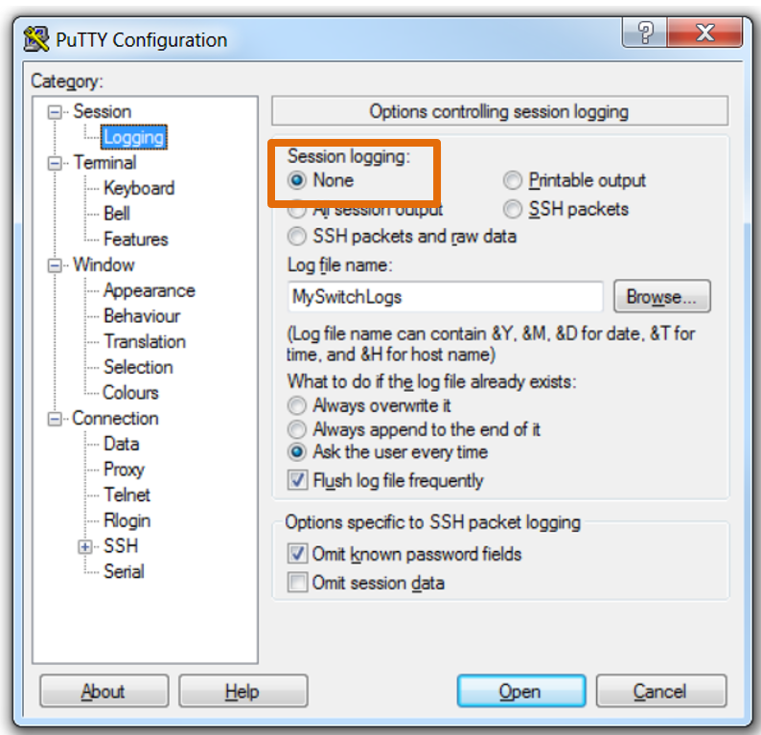
Save Configurations Capture Configuration to a Text File
Configuration files can also be saved and archived to a text document for editing or reuse later. For example, assume a switch has been configured and the running config has been saved.
Connect to the switch using PuTTY or Tera Term. | Enable logging and assign a name and file location to save the log file. | Generate text to be captured as text displayed in the terminal window will also be placed into the chosen file. | Disable logging in the terminal software by choosing None in the Session logging option.
Execute the show running-config or show startup-config command at the privileged EXEC prompt.
Notes:
2.2 – Basic Device Configuration
2.2.3 – Save Configurations
2.2.3.3 – Capture Configuration to a Text File

Slide 52
Save Configurations Capture Configuration to a Text File (Cont.)
The text file created can be used as a record of how the device is currently implemented and be used to restore a configuration. The file would require editing before being used to restore a saved configuration to a device.
To restore a configuration file to a device:
Enter global configuration mode on the device.
Copy and paste the text file into the terminal window connected to the switch.
The text in the file will be applied as commands in the CLI and become the running configuration on the device.
Notes:
2.2 – Basic Device Configuration
2.2.3 – Save Configurations
2.2.3.3 – Capture Configuration to a Text File

Slide 53
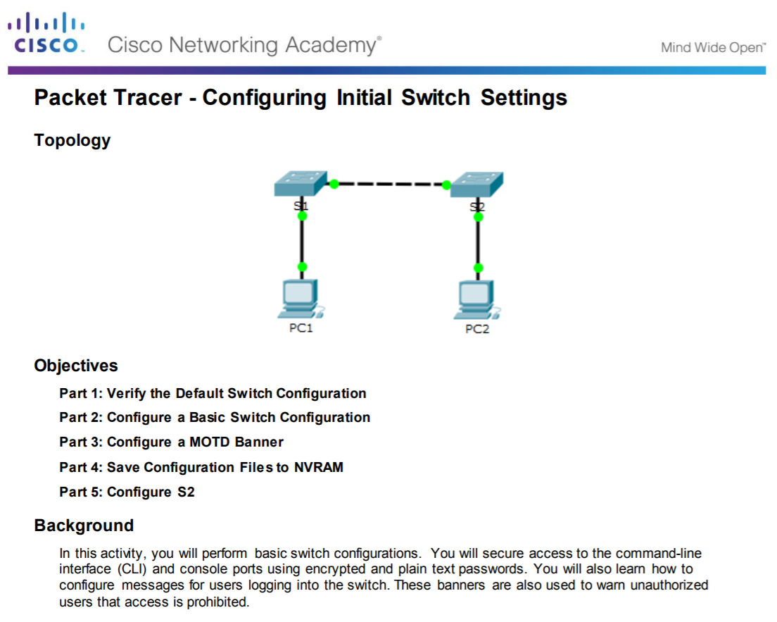
Save Configuration Packet Tracer - Configuring Initial Switch Settings
Notes:
2.2 – Basic Device Configuration
2.2.3 – Save Configurations
2.2.3.4 – Packet Tracer – Configuring Initial Switch Settings

Slide 54
2.3 Address Schemes
Notes:
2 - Configure a Network Operating System
2.3 – Address Schemes

Slide 55
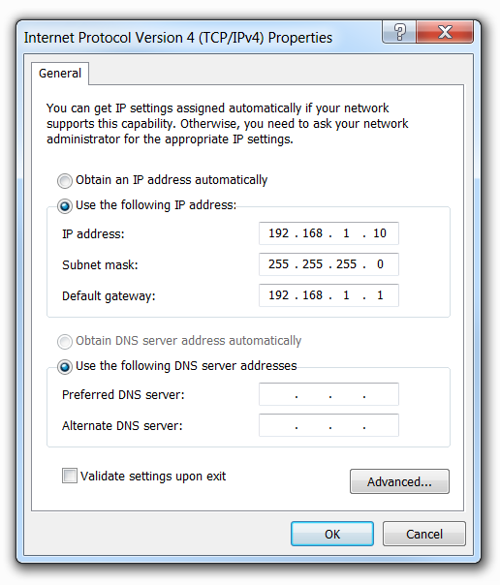
Ports and Addresses IP Addressing Overview
Each end device on a network (e.g., PCs, laptops, servers, printers, VoIP phones, security cameras, …) require an IP configuration consisting of:
IP address
Subnet mask
Default gateway (optional for some devices)
IPv4 addresses are displayed in dotted decimal format consisting of:
4 decimal numbers 0 and 255
Separated by decimal points (dots)
E.g., 192.168.1.10, 255.255.255.0, 192.168.1.1
Notes:
2.3 – Address Schemes
2.3.1 – Ports and Addresses
2.3.1.1 – IP Addresses

Slide 56
Ports and Addresses Interfaces and Ports
Cisco IOS Layer 2 switches have physical ports for devices to connect. However, these ports do not support Layer 3 IP addresses.
To remotely connect to and manage a Layer 2 switch, it must be configured with one or more switch virtual interfaces (SVIs).
Each switch has a default VLAN 1 SVI.
Note: A Layer 2 switch does not need an IP address to operate. The SVI IP address is only used to remotely manage a switch.
Notes:
2.3 – Address Schemes
2.3.1 – Ports and Addresses
2.3.1.2 – Interfaces and Ports

Slide 57
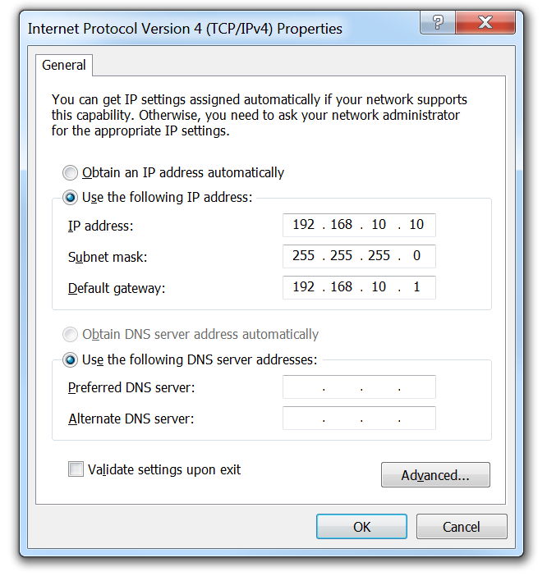
Configure IP Addressing Manual IP Address Configuration for End Devices
To manually configure an IP address on a Windows host:
Open the Control Panel > Network Sharing Center > Change adapter settings and click on the adapter. | Configure the IPv4 address and subnet mask information, and default gateway and then click OK.
Right-click on the adapter and select Properties to display the Local Area Connection Properties window.
Highlight Internet Protocol Version 4 (TCP/IPv4) and click Properties to open the Internet Protocol Version 4 (TCP/IPv4) Properties window
Click Use the following IP address to manually configure the IPv4 address configuration.
Note: Windows 10 manual IPv4 configuration is provided as Supplemental material at the end of this presentation
Notes:
2.3 – Address Schemes
2.3.2. – Configure IP Addressing
2.3.2.1 - Manual IP Address Configuration for End Devices

Slide 58
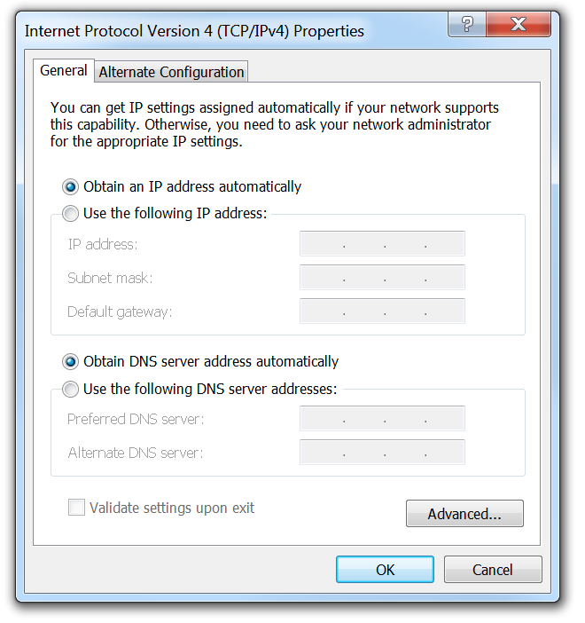
Configure IP Addressing Automatic IP Address Configuration for End Devices
To assign the IP configuration using a Dynamic Host Configuration Protocol (DHCP) server:
Open the Control Panel > Network Sharing Center > Change adapter settings and click on the adapter. | Click Obtain an IP address automatically and click on OK.
Right-click on the adapter and select Properties to display the Local Area Connection Properties window.
Highlight Internet Protocol Version 4 (TCP/IPv4) and click Properties to open the Internet Protocol Version 4 (TCP/IPv4) Properties window
Use the ipconfig Windows Command prompt command to verify a host IP address.
Notes:
2.3 – Address Schemes
2.3.2. – Configure IP Addressing
2.3.2.2 - Automatic IP Address Configuration for End Devices

Slide 59
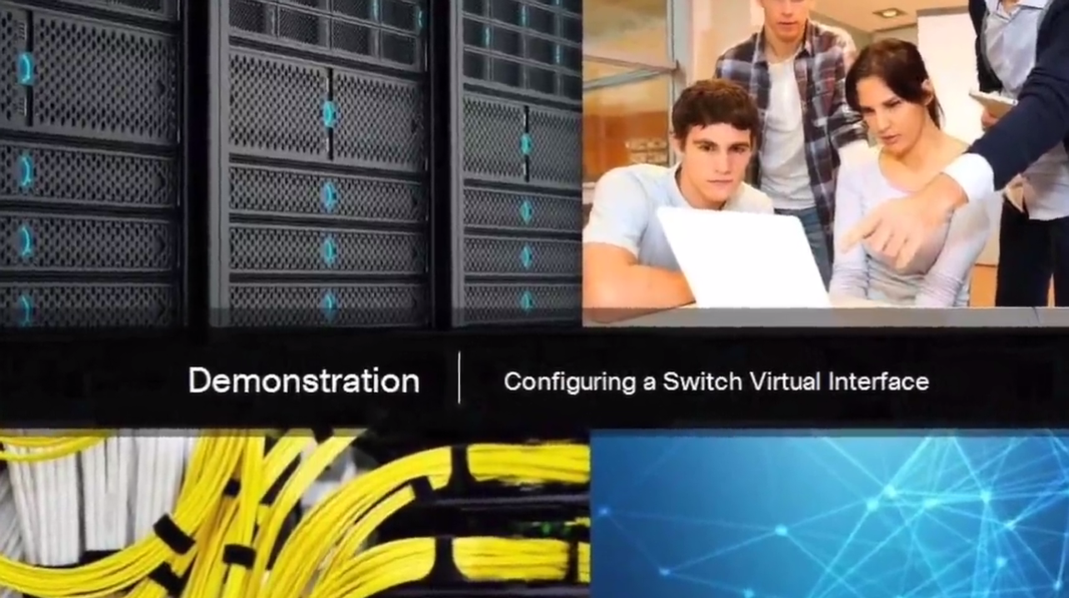
Configure IP Addressing Switch Virtual Interface
To remotely manage a switch, it must also be configured with an IP configuration:
However, a switch does not have a physical Ethernet interface that can be configured.
Instead, you must configure the VLAN 1 switch virtual interface (SVI).
The VLAN 1 SVI must be configured with:
IP address - Uniquely identifies the switch on the network
Subnet mask - Identifies the network and host portion in the IP address
Enabled - Using the no shutdown command.
Use the show ip interface brief privileged EXEC command to verify.
Notes:
2.3 – Address Schemes
2.3.2. – Configure IP Addressing
2.3.2.3 – Switch Virtual Interface Configuration (page 2.3.2.4 has no content, only a Syntax Checker)

Slide 60
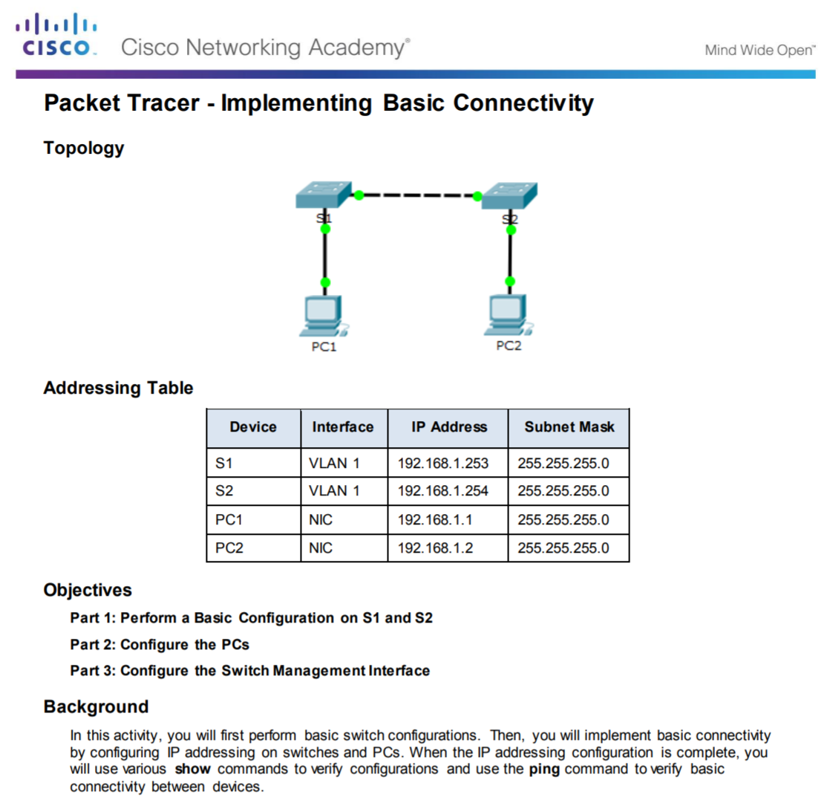
Configure IP Addressing Packet Tracer - Implementing Basic Connectivity
Notes:
2.3 – Address Schemes
2.3.2. – Configure IP Addressing
2.3.2.5 – Packet Tracer - Implementing Basic Connectivity

Slide 61
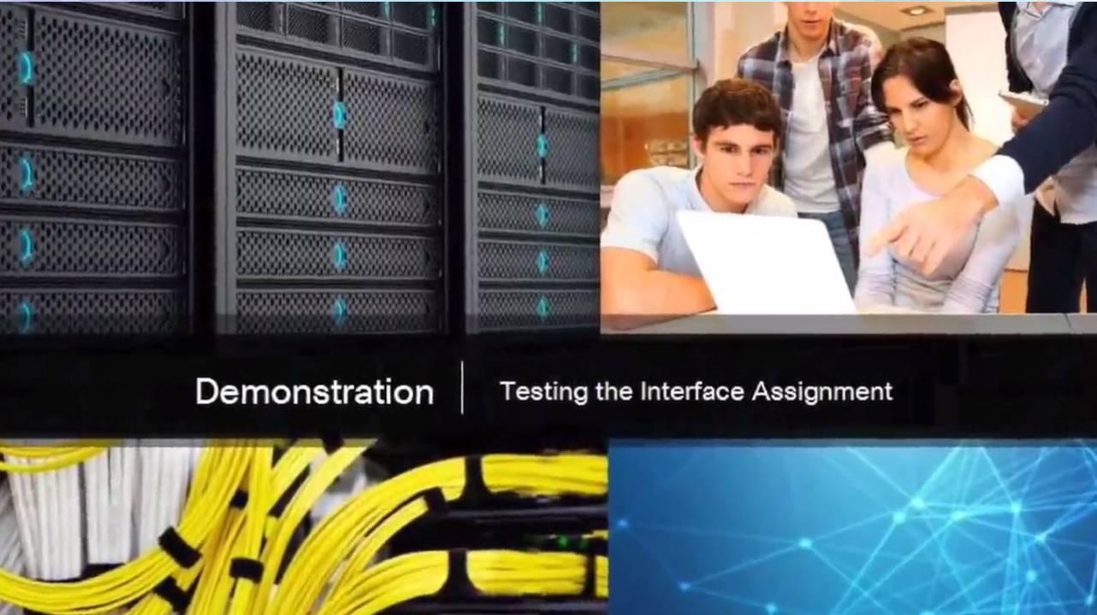
Verifying Connectivity Interface Addressing Verification
The IP configuration on a Windows host is verified using the ipconfig command.
To verify the interfaces and address settings of intermediary devices like switches and routers, use the show ip interface brief privileged EXEC command.
Notes:
2.3 – Address Schemes
2.3.3. – Verifying Connectivity
2.3.3.1 – Interface Addressing Verification

Slide 62

Verifying Connectivity End-to-End Connectivity Test
The ping command can be used to test connectivity to another device on the network or a website on the Internet.
Notes:
2.3 – Address Schemes
2.3.3. – Verifying Connectivity
2.3.3.2 – End-to-End Connectivity Test

Slide 63
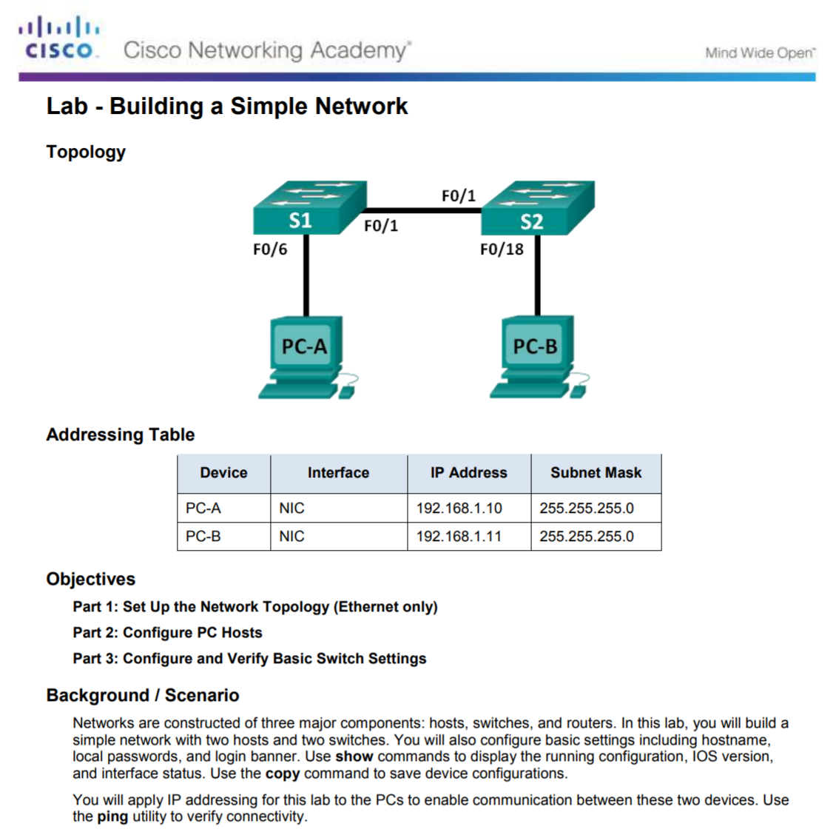
Verifying Connectivity Lab – Building a Simple Network
Notes:
2.3 – Address Schemes
2.3.3. – Verifying Connectivity
2.3.3.3 – Lab – Build a Simple Network

Slide 64
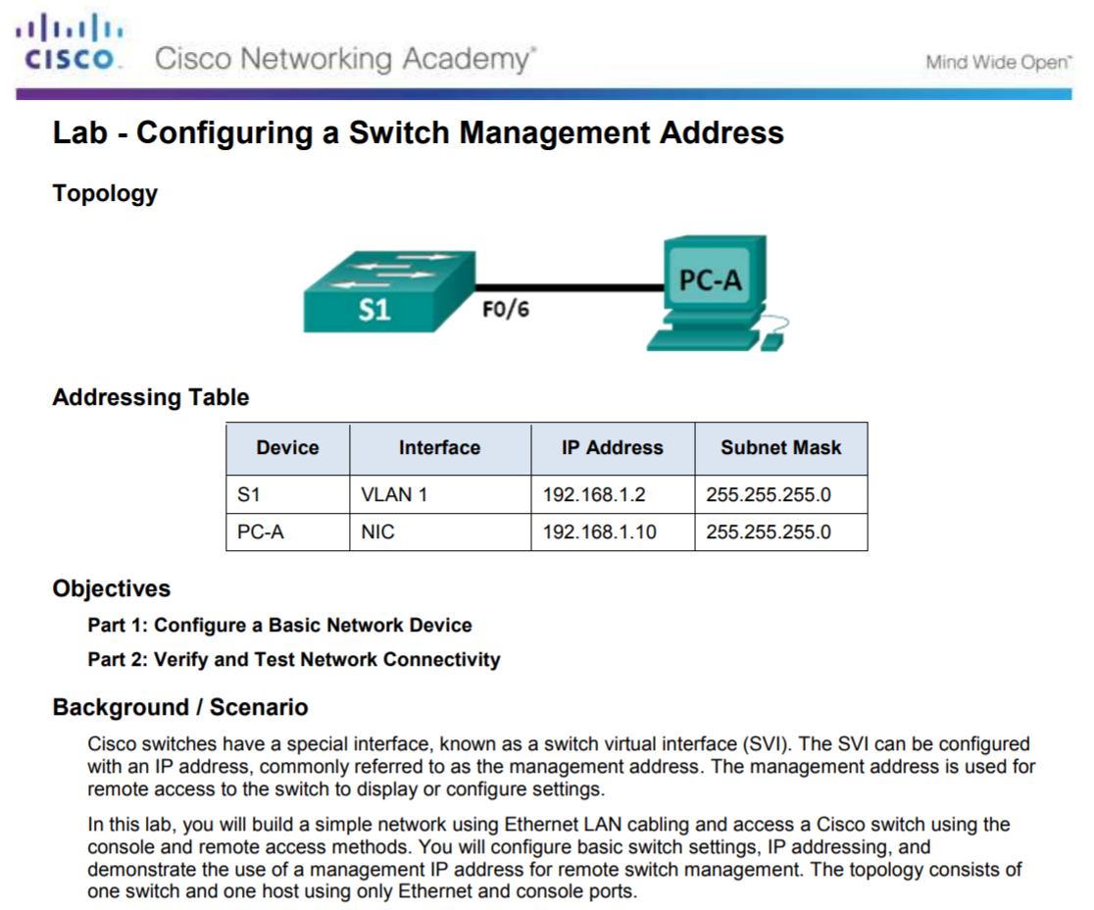
Verifying Connectivity Lab – Configuring a Switch Management Address
Notes:
2.3 – Address Schemes
2.3.3. – Verifying Connectivity
2.3.3.4 – Lab – Configuring a Switch Management Address

Slide 65
2.4 Chapter Summary
Notes:
2 - Configure a Network Operating System
2.4 – Summary

Slide 66

Conclusion Class Activity – Tutor Me
Notes:
2.4 – Summary
2.4.1 – Conclusion
2.4.1.1 – Class Activity – Tutor Me

Slide 67
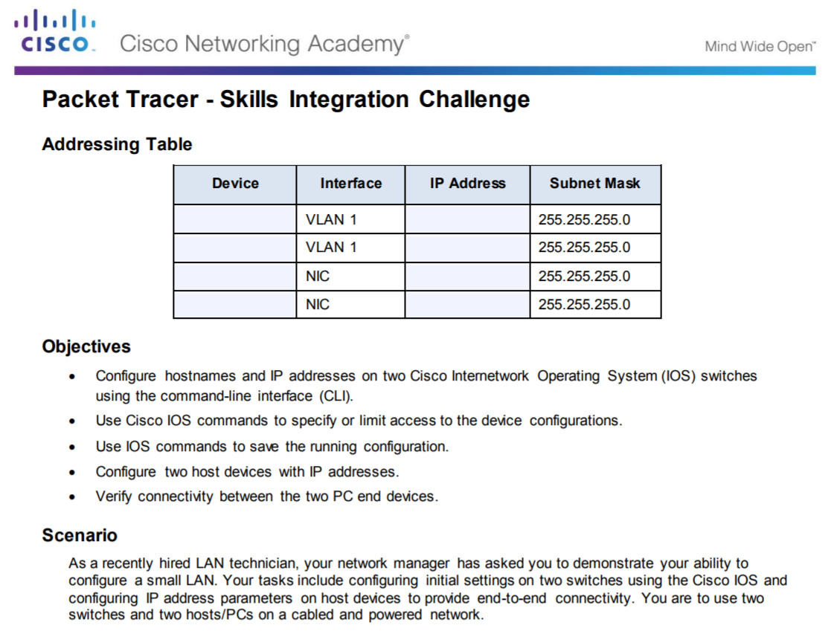
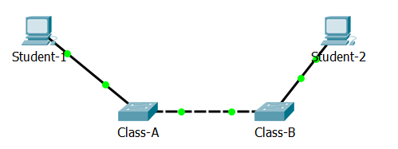
Conclusion Packet Tracer - Skills Integration Challenge
Notes:
2.4 – Summary
2.4.1 – Conclusion
2.4.1.2 – Packet Tracer - Skills Integration Challenge

Slide 68
Conclusion Chapter 2: Configure a Network Operating System
Explain the features and functions of Cisco IOS Software.
Configure initial settings on a network device using the Cisco IOS software.
Given an IP addressing scheme, configure IP address parameters on end devices to provide end-to-end connectivity in a small to medium-sized business network.
Notes:
2.4 – Summary
2.4.1 – Conclusion
2.4.1.3 – Chapter 2: Configure a Network Operating System

Slide 69
Section 2.1 New Terms and Commands
kernel shell Command-line interface (CLI) Graphical user interface (GUI) Cisco IOS Firmware Console Out-of-band SSH Telnet Auxiliary port (AUX) PuTTY Tera Term SecureCRT | OS X Terminal Cisco IOS modes User EXEC mode Privileged EXEC mode Global Configuration Mode Line configuration mode Interface configuration mode enable command disable command exit command end command Key combination – Ctrl+Z Context-Sensitive Help Command Syntax Check | CLI Hot Keys and Shortcuts Hostnames
Notes:
New Terms and Commands

Slide 70
Section 2.2 New Terms and Commands
hostname name Strong passwords enable secret class line console 0 password cisco login line vty 0 15 service password-encryption banner motd # the message of the day # Startup configuration Random Access Memory (NVRAM) Running configuration Random Access Memory (RAM) | show running-config copy running-config startup-config reload
Notes:
New Terms and Commands

Slide 71
Section 2.3 New Terms and Commands
IPv4 address Subnet mask Default gateway Physical ports Virtual interface Copper Fiber Optics Wireless Ethernet Local Area Network (LAN) Layer 2 switch Layer 3 addresses Switch virtual interface (SVI) | Dynamic Host Configuration (DHCP) Domain Name System (DNS) ipconfig command prompt interface vlan 1
Notes:
New Terms and Commands

Slide 73
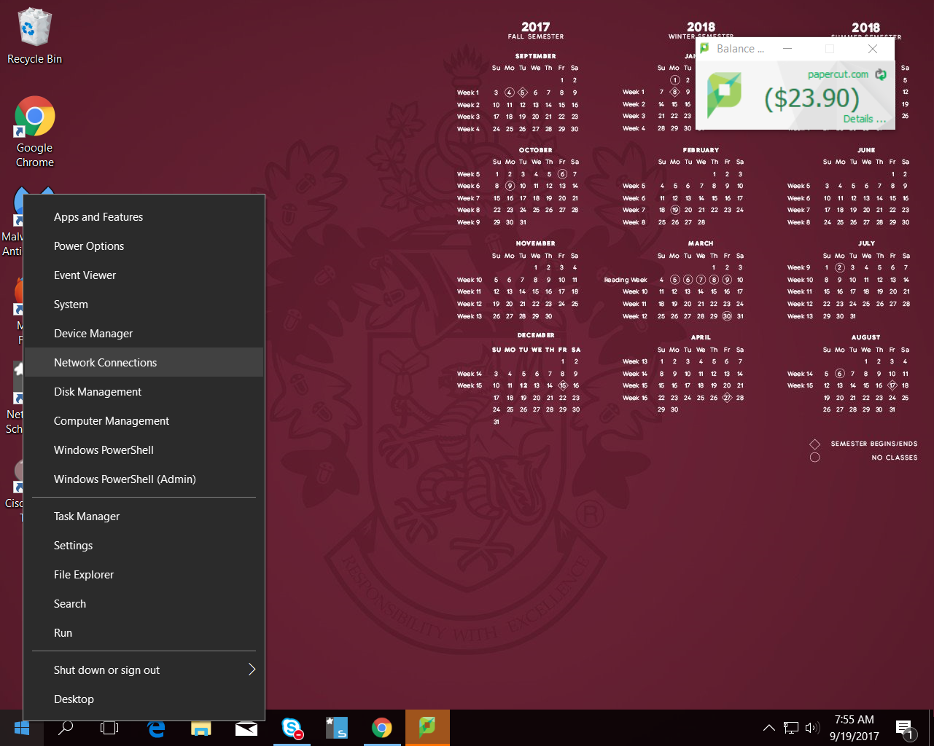
Windows 10 (Supplemental)
Right click the Windows button

Slide 74

Windows 10 (Supplemental)
Click on “Change adapter options”

Slide 75
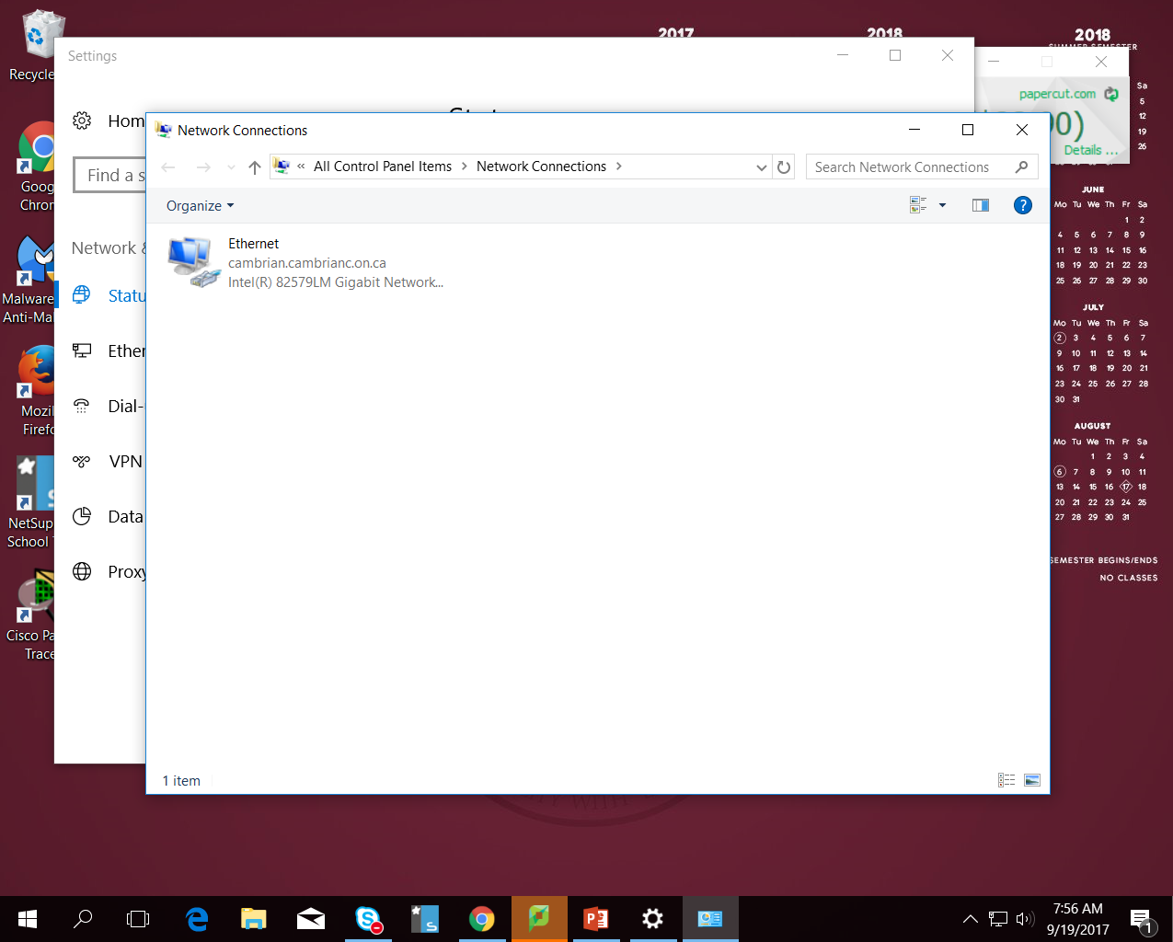
Windows 10 (Supplemental)
Right-Click on “Ethernet”

Slide 76
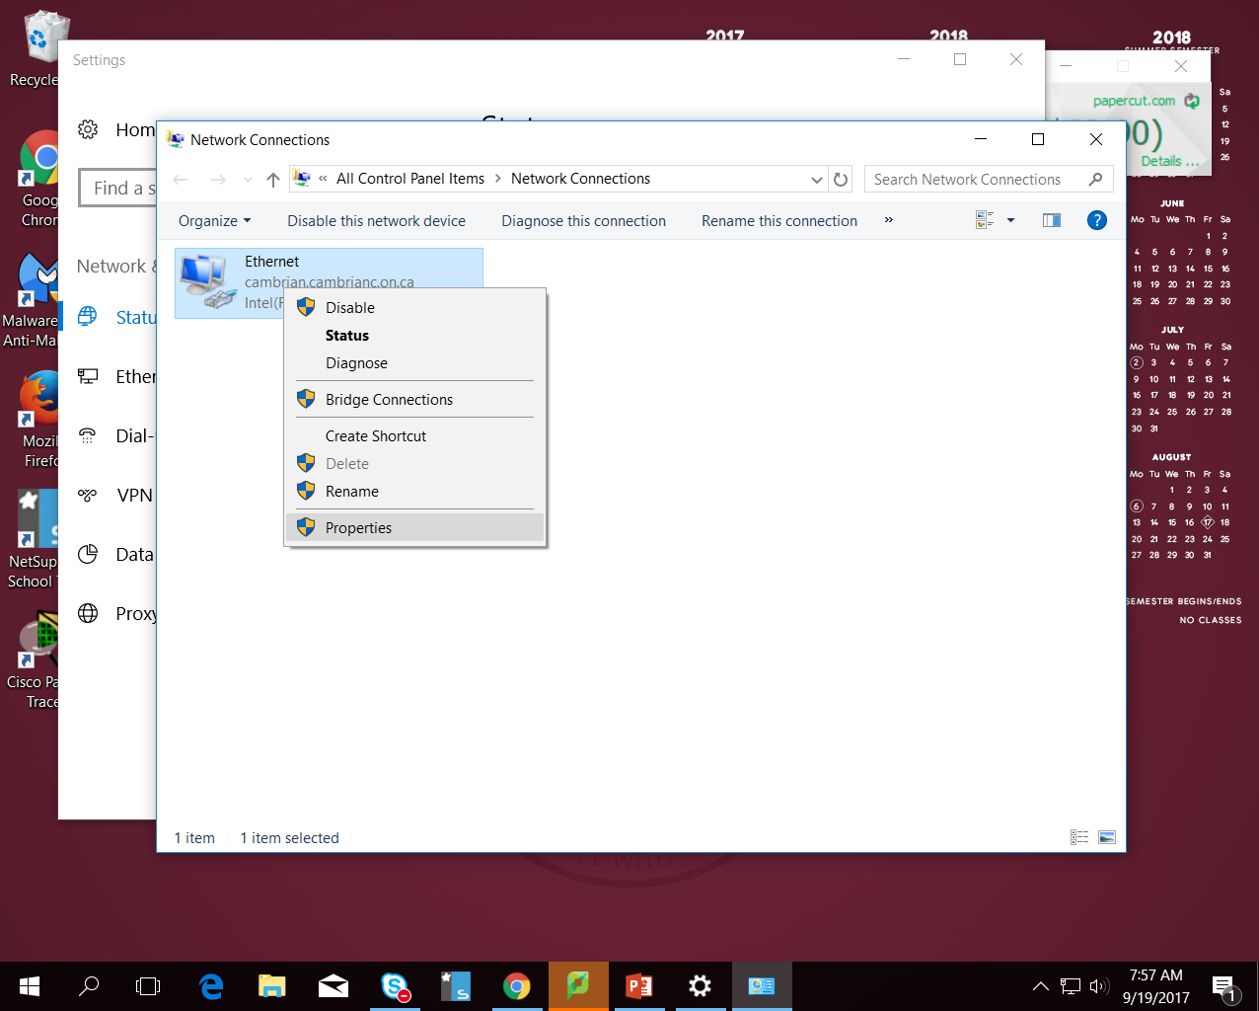
Windows 10 (Supplemental)
Click on “Properties”

Slide 77
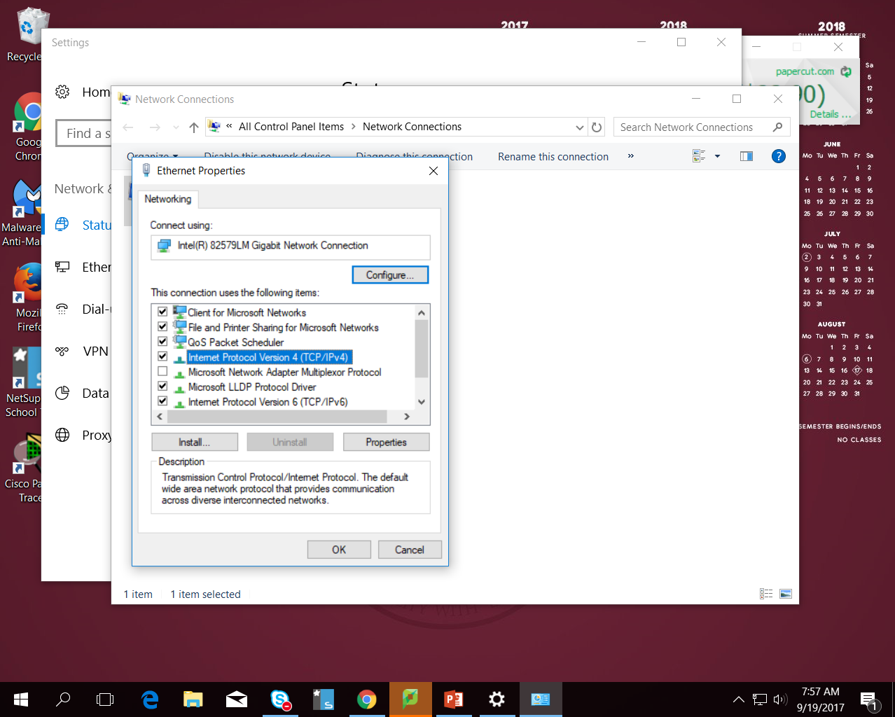
Windows 10 (Supplemental)
Click on “Internet Protocol Version 4 (TCP/IPv4)”
Click on “Properties”

Slide 78
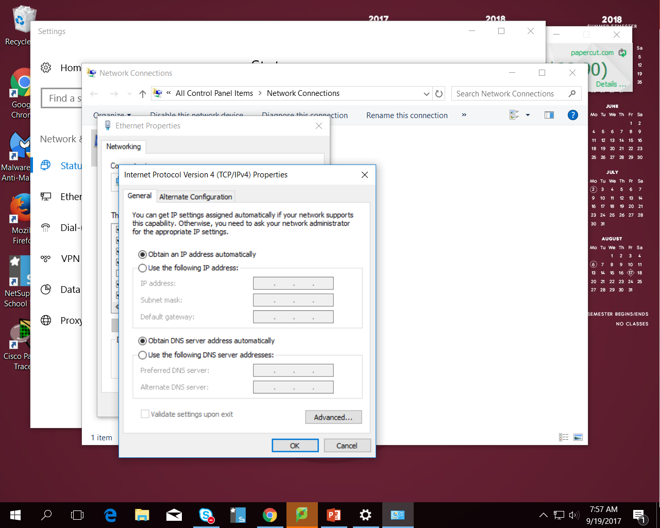
Windows 10 (Supplemental)

